Slide 1
Cassandra - A Decentralized Structured Storage System
Ankita Wankhede
Sree Naga Sayana
Hari Manasa Ganganagunta
Neil Miller

Slide 2
AGENDA
Introduction
Related Work
Data Model
Casandra API
System Architecture
Partitioning
Replication
Membership
Bootstrapping
Scaling the cluster
Local persistence
Conclusion

Slide 3

HISTORY
Cassandra is a free and open-source distributed NoSQL database management system.
Authors Avinash Lakshman and Prashant Malik were part of the team, that initially developed Cassandra at Facebook to power the Facebook inbox search feature.
Later in July of 2008, Facebook released Cassandra as an open source project on google code.
In March of 2009, Cassandra became an Apache incubator project.

Slide 4
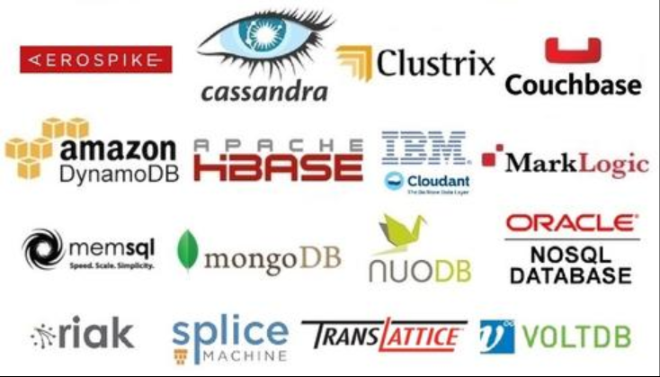
Why NoSQL Databases
A NoSQL database provides a mechanism for storage and retrieval of data that is modeled in means other than the tabular relations used in relational databases.
NoSQL databases are increasingly used in big data and real-time web applications.
We have various approaches to classify NoSQL databases

Slide 5
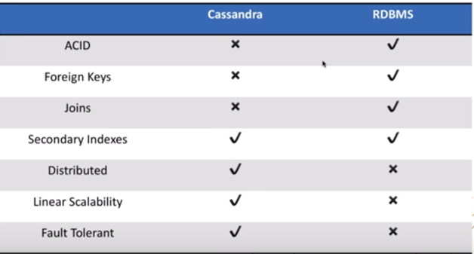
NOSQL VS RDBMS

Slide 6
INTRODUCTION
Apache Cassandra, a top level Apache project born at Facebook and built on Amazon’s Dynamo and Google’s Bigtable, is a distributed database for managing large amounts of structured data across many commodity servers, while providing highly available service and no single point of failure.
Apache Cassandra offers capabilities that relational databases and other NoSQL databases simply cannot match such as: continuous availability, linear scale performance, operational simplicity and easy data distribution across multiple data centers and cloud availability zones.
Cassandra introduced the Cassandra Query Language (CQL). CQL is a simple interface for accessing Cassandra, as an alternative to the traditional Structured Query Language (SQL).

Slide 7
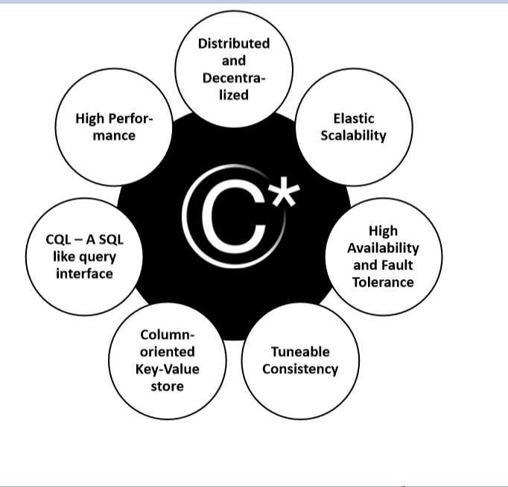
Key Features

Slide 8

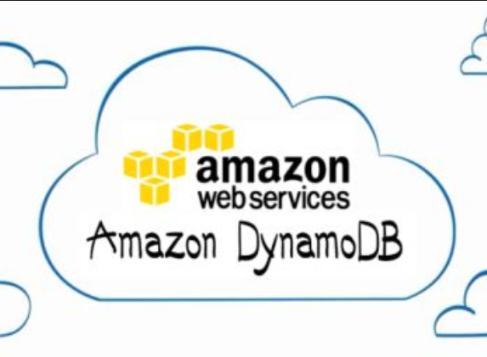

RELATED WORK
Google File System uses a simple design with a single master server for hosting the entire metadata and where the data is split into chunks and stored in chunk servers. However the GFS master is now made fault tolerant using the Chubby abstraction
Dynamo is a storage system that is used by Amazon to store and retrieve user shopping carts. Dynamo’s Gossip based membership algorithm helps every node maintain information about every other node.
Bigtable provides both structure and data distribution but relies on a distributed file system for its durability.

Slide 9
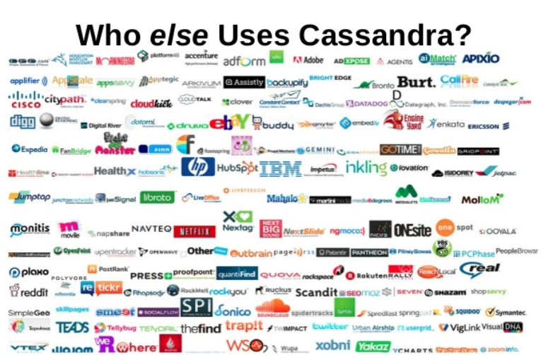
RELATED WORK

Slide 10
Data Model
Cassandra database is distributed over several machines that operate together.
The outermost container is known as the Cluster
Cassandra arranges the nodes in a cluster, in a ring format, and assigns data to the nodes
Keyspace: Keyspace is the outermost container for the data in Cassandra
Attributes:
Replication factor
Replica Placement Strategy
Column families

Slide 11
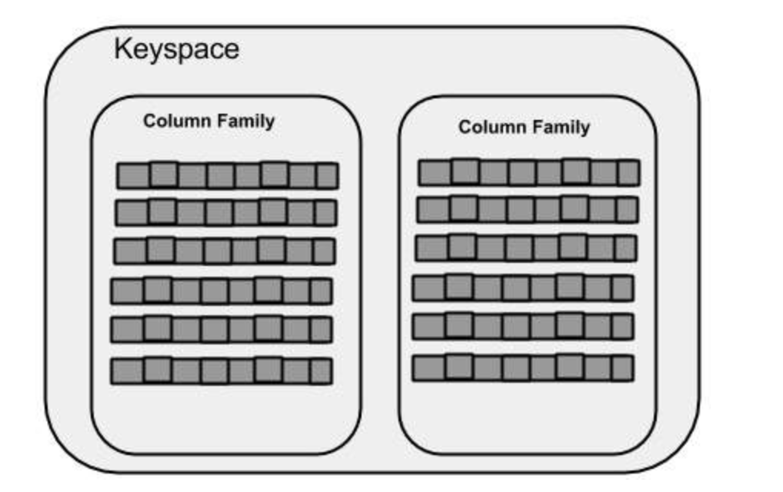
Continued..
Replica Placement Strategies:
Simple Strategy
Old network topology strategy
Network topology strategy
Column Families: Keyspace is a container for a list of one or more column families.
Each column family ->Collection of rows -> Ordered Columns
https://www.tutorialspoint.com/cassandra/cassandra_data_model.htm

Slide 12
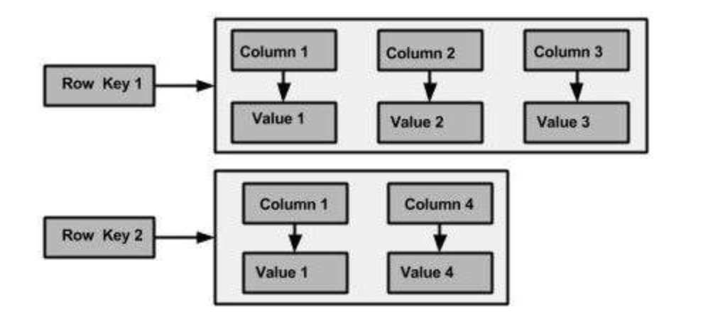
The column families are defined, the columns are not.
You can freely add any column to any column family at any time.
Cassandra does not force individual rows to have all the columns.
Row Key in a table is a string with no size restrictions, although typically 16 to 36 bytes long

Slide 13
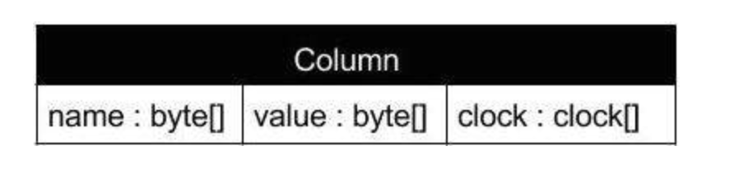
Column:
A column is the basic data structure of Cassandra with three values
Super Column:
super column stores a map of sub-columns.
Generally column families are stored on disk in individual files.
It is important to keep column families that you are likely to query together in the same column family.
Syntax:

Slide 14
Sorting of columns with in a super column or simple column family can be achieved in two ways.
Can be sorted by time or by name.

Slide 15
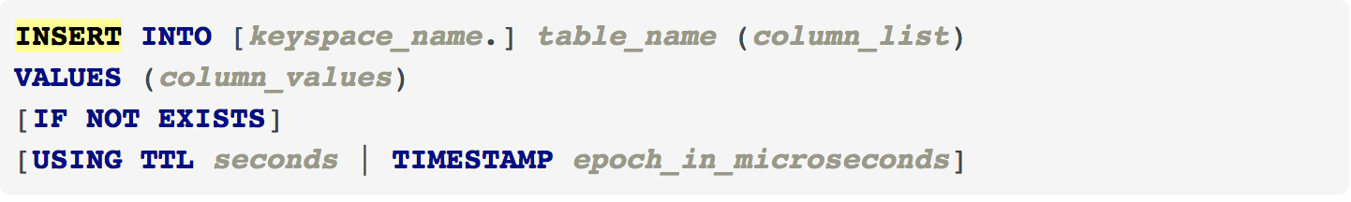
API
The Cassandra API consists of three simple methods
INSERT
GET
DELETE
INSERT:
Inserts an entire row into an existing row, using the primary key.

Slide 16
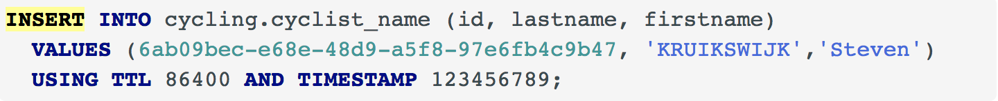
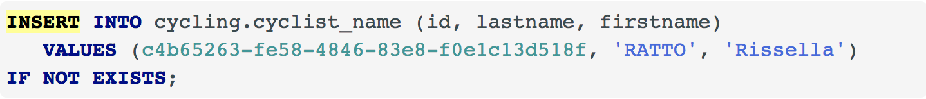
Examples:

Slide 17
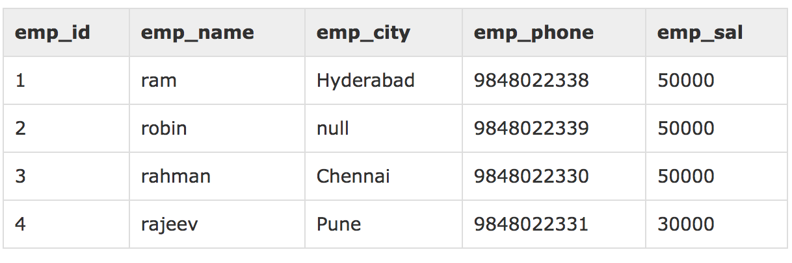
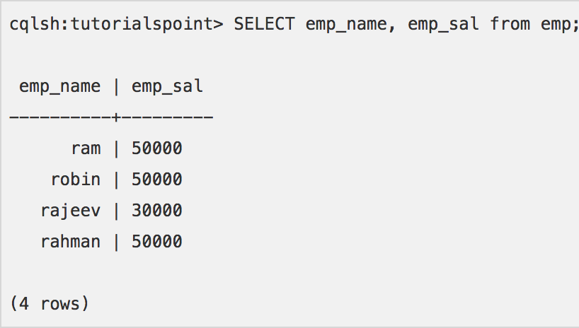
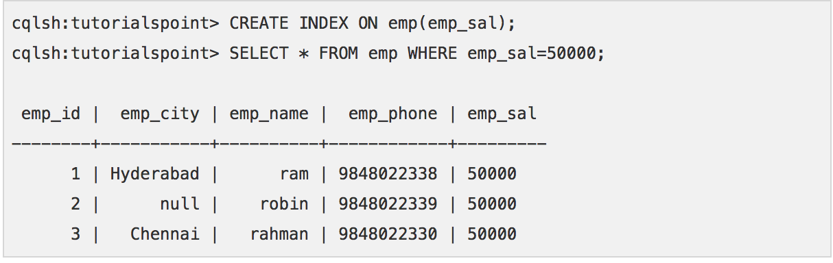
GET/READ:
Assume there is a table in the keyspace named emp with the following details

Slide 18
Delete

Slide 19
System Architecture:
The design goal of Cassandra is to handle big data workloads across multiple nodes without any single point of failure
All the nodes in a cluster play the same role. Each node is independent and at the same time interconnected to other nodes.
Typically a read/write request for a key gets routed to any node in the Cassandra cluster and the node then determines the replicas for this particular key
Writes: System routes the request to the replicas and waits for a quorum of replicas to acknowledge the completion of the writes.
Reads: Based on the consistency guarantees required by the client, the system either routes the requests to the closest replica or routes the request to all replicas and waits for a quorum of responses.

Slide 20
System Architecture
Partitioning
Replication
Membership
Failure handling
scaling

Slide 21
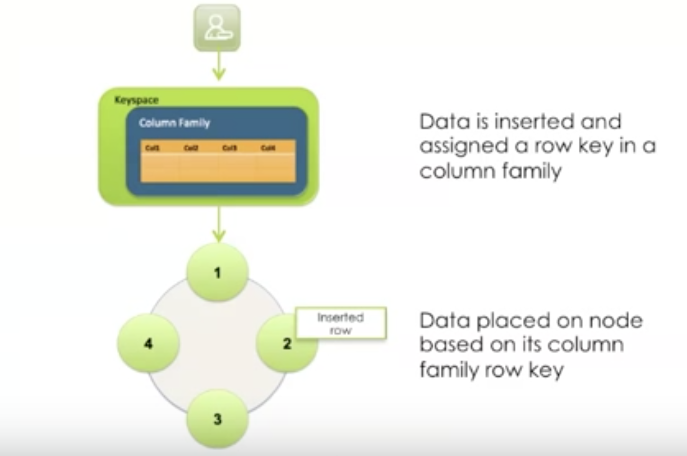
Partitioning
Cassandra is a distributed database management system that easily and transparently partitions data across all participating nodes in a database cluster.
Cassandra has the ability to scale incrementally and this requires the ability to dynamically partition the data over the set of nodes in the cluster.
Cassandra partitions data across cluster using Consistent Hashing
https://www.youtube.com/watch?v=u7nHyzFHqMA

Slide 22
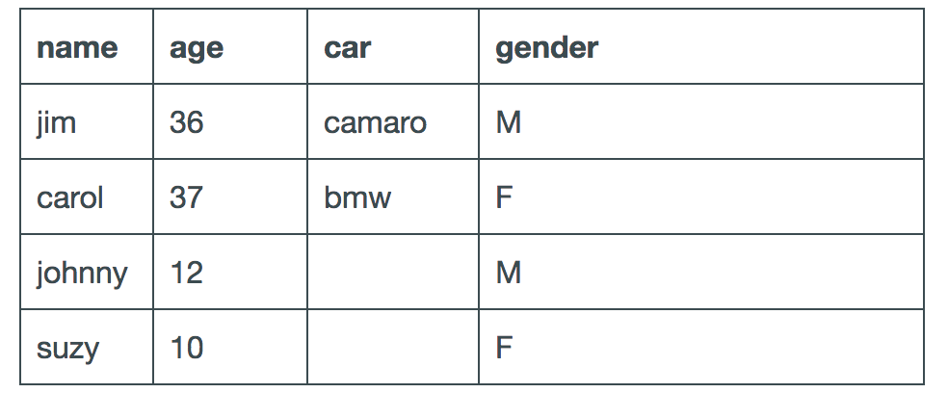
Consistent Hashing
Consistent hashing allows distribution of data across a cluster to minimize reorganization when nodes are added or removed.
For example, if you have the following data:

Slide 23
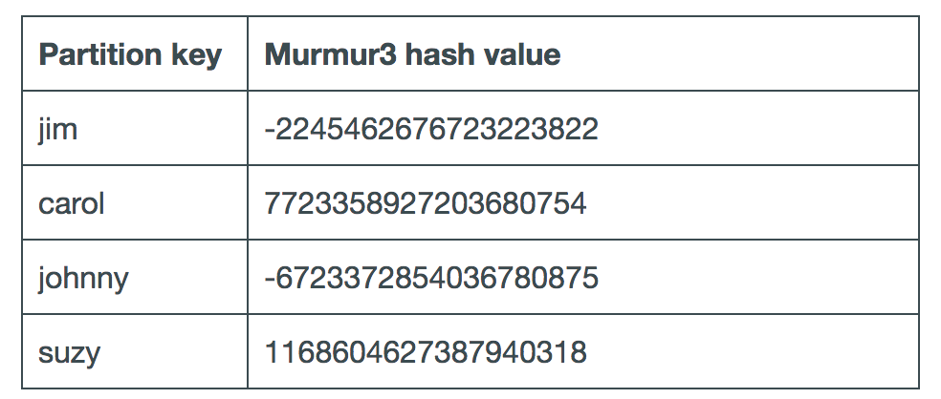
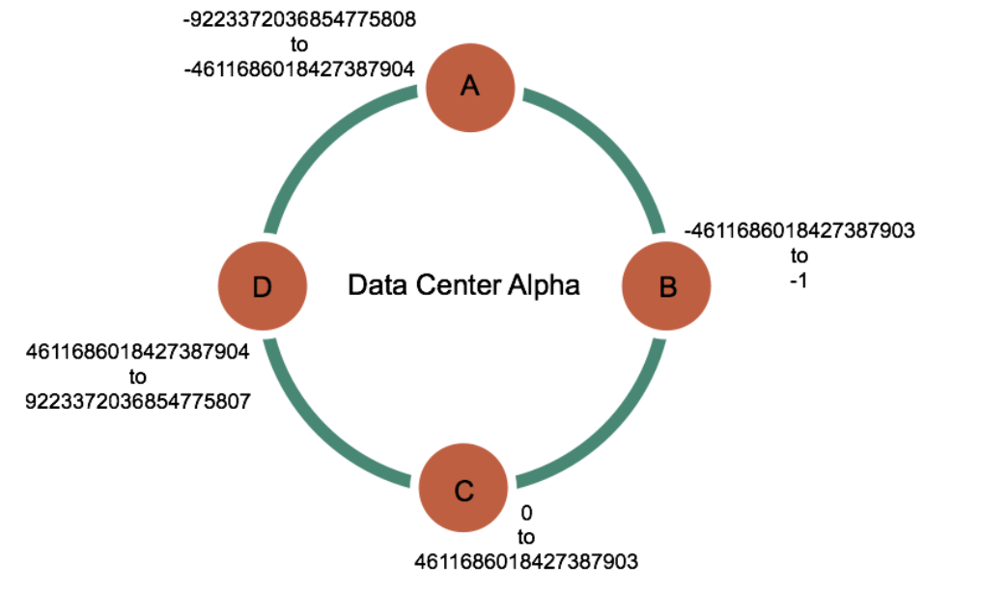
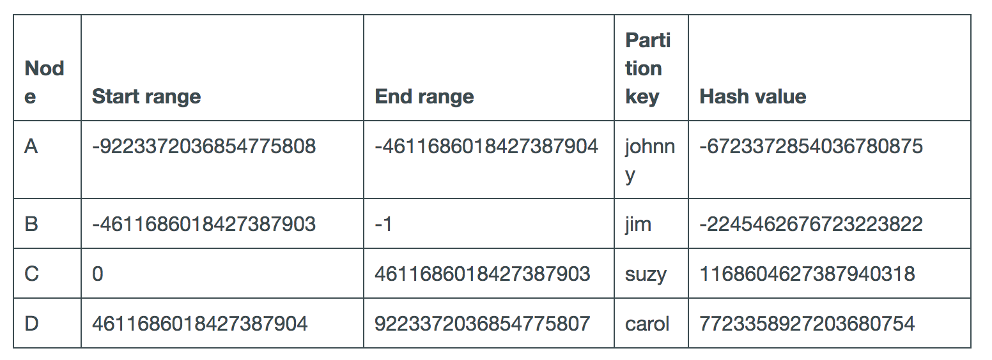
https://docs.datastax.com/en/cassandra/3.0/cassandra/architecture/archDataDistributeHashing.html?hl=consistent%2Chashing

Slide 24
Principal advantage: Departure or arrival of a node only affects its immediate neighbors and other nodes remain unaffected.
Challenges:
The random position assignment of each node on the ring leads to non-uniform data and load distribution
The basic algorithm is oblivious to the heterogeneity in the performance of nodes
These can be addressed in two ways:
Nodes to get assigned to multiple positions in the circle
To analyze load information on the ring and have lightly loaded nodes move on the ring to alleviate heavily loaded nodes.

Slide 25
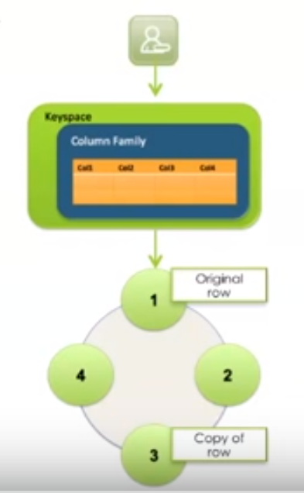
Replication
To ensure fault tolerance and no single point of failure.
Can replicate one or more copies of every row in a column family.
Replication is controlled by replication factor at a keyspace level in Cassandra.
www.datastax.com

Slide 26
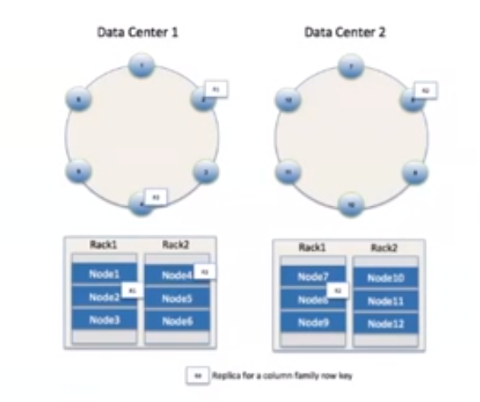
Replication Strategies
Simple Strategy
Network Topology
Strategy.
https://docs.datastax.com/en/cassandra/2.1/cassandra

Slide 27
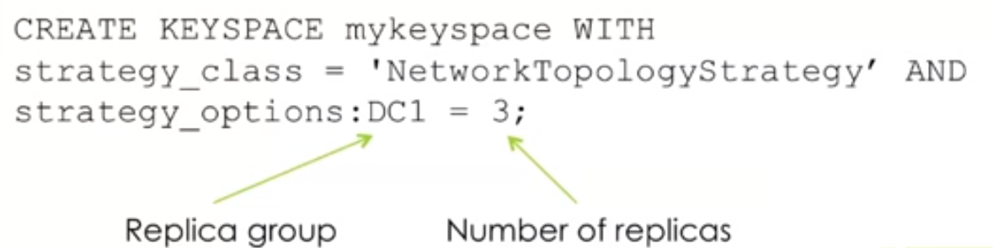
Replication Strategies
Network Topology Strategy
Syntax:
www.docs.datastax.com

Slide 28
Replication Policies
Rack Aware
Rack Unaware
Datacenter Aware

Slide 29
Zoo Keeper
Cassandra system elects a leader amongst its nodes using a system called Zookeeper.
All nodes on joining the cluster contact the leader who tells them for what ranges they are replicas for

Slide 30
Membership
Cluster membership in Cassandra is based on Scuttlebutt
A very efficient anti-entropy Gossip based mechanism.
Disseminate other system related control state.

Slide 31
Failure Detection
A node can locally determine if any other node in the system is up or down.
Cassandra uses a modified version of the Φ Accrual Failure Detector
The basic idea is to express the value of Φ on a scale that is dynamically adjusted to reflect network and load conditions at the monitored nodes.

Slide 32
Failure Detection
Every node in the system maintains a sliding window of inter-arrival times of gossip messages from other nodes in the cluster.
The distribution of these inter-arrival times is determined and Φ is calculated.

Slide 33

Bootstrapping
On startup, node chooses random token for its position in ring
Position is persisted locally and with Zookeeper then gossiped around the cluster
Node determines initial contact points from local configuration file or from Zookeeper
https://academy.datastax.com/resources/brief-introduction-apache-cassandra

Slide 34
Explicit Membership Mechanism
Because:
Node outage is assumed to be temporary
Manual or configuration error could have new nodes join unintentionally
Adding and removing nodes is done explicitly
Administrator uses command line tool or browser portal on node to issue membership changes

Slide 35
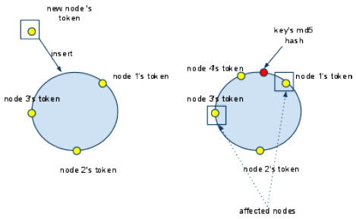
Scaling the Cluster
New node is added to balance load by splitting range of keys
Existing node streams data in range to new node
Transfer rate up to 40 MB/sec
Attempts being made to parallelize bootstrap transfer
http://www.cellopoint.com/media_resources/blog/2010/05/cassandra-data-model

Slide 36
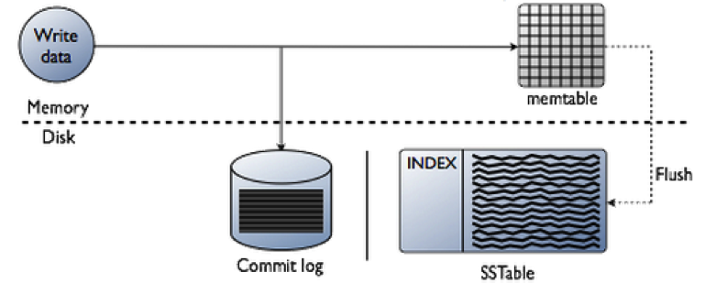
Local Persistence
Data stored on local file system
Writes first go to commit log to ensure recoverability
In memory structure (memtable) updated after commit log
Commit log stored on dedicated disk to maximize throughput
https://academy.datastax.com/resources/brief-introduction-apache-cassandra

Slide 37
Local Persistence
memtable persisted to disk when it grows bigger than a configurable size
Writes are sequential – buffering allows for high performance
Data written to disk in immutable SSTable files
Indices written for efficient lookup by row key
https://academy.datastax.com/resources/brief-introduction-apache-cassandra

Slide 38
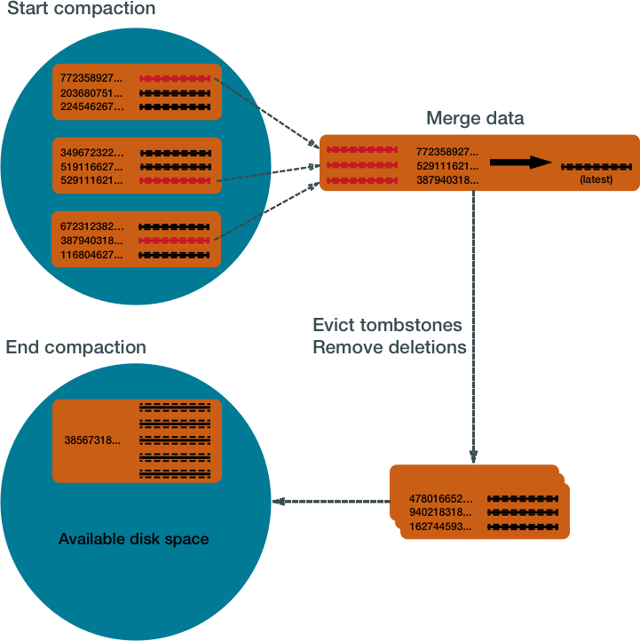
Data Compaction
Instead of overwriting rows for insert and update, Cassandra stores rows with time stamp
Background process periodically merges SSTable files
Merging consolidates timestamped versions of rows into one representative row
Removes rows that have been deleted
Similar to compaction in Bigtable
https://docs.datastax.com/en/cassandra/3.0/cassandra/dml/dmlHowDataMaintain.html

Slide 39
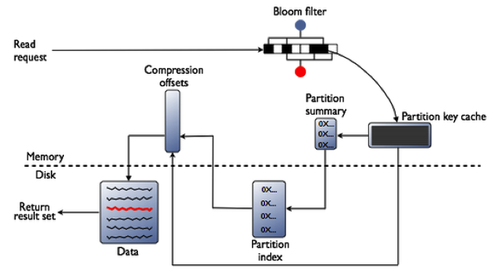
Read Operations
Read operation first queries in-memory data
If not found, searches files on disk newest to oldest
Bloom filter summarizes keys in each file to avoid lookup into files that don’t contain key
https://academy.datastax.com/resources/brief-introduction-apache-cassandra

Slide 40
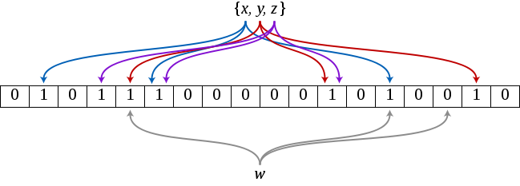
Bloom Filter
“A Bloom filter is a space-efficient probabilistic data structure, conceived by Burton Howard Bloom in 1970, that is used to test whether an element is a member of a set”
https://en.wikipedia.org/wiki/Bloom_filter

Slide 41
Read Operations
Columns for each key are written in 256k partitions
Column indices are maintained for each partition to allow reads to jump to right disk chunk.
Partition size is configurable, but Facebook experience shows 256K to be best
https://academy.datastax.com/resources/brief-introduction-apache-cassandra

Slide 42
Conclusion
Cassandra provides a scalable, high performance storage system
System is flexible with wide applicability
Architecture allows for clusters to grow to hundreds of nodes in multiple data centers
Future work involves adding compression, supporting atomicity across keys (transactions) and secondary index support

Slide 43
Thank you

